Slide 1



Spotify Songs Popularity Analysis Project
DATA110
Sandra Aching

Slide 2

1
Introduction
Agenda
2
EDA Process and Insights
Topics that will be covered
3
Summary of Findings
Recommendations and Future Considerations
4

Slide 3



Introduction
The Spotify Songs Dataset and why it was chosen
Spotify is a music/audio streaming app that allows its users to access a variety of songs and podcasts
The dataset was provided by Professor Rachel
The dataset includes attributes and features of 2000 songs from the years 1998-2020
Personal interest in understanding how attributes of a song affect a song’s popularity

Slide 4

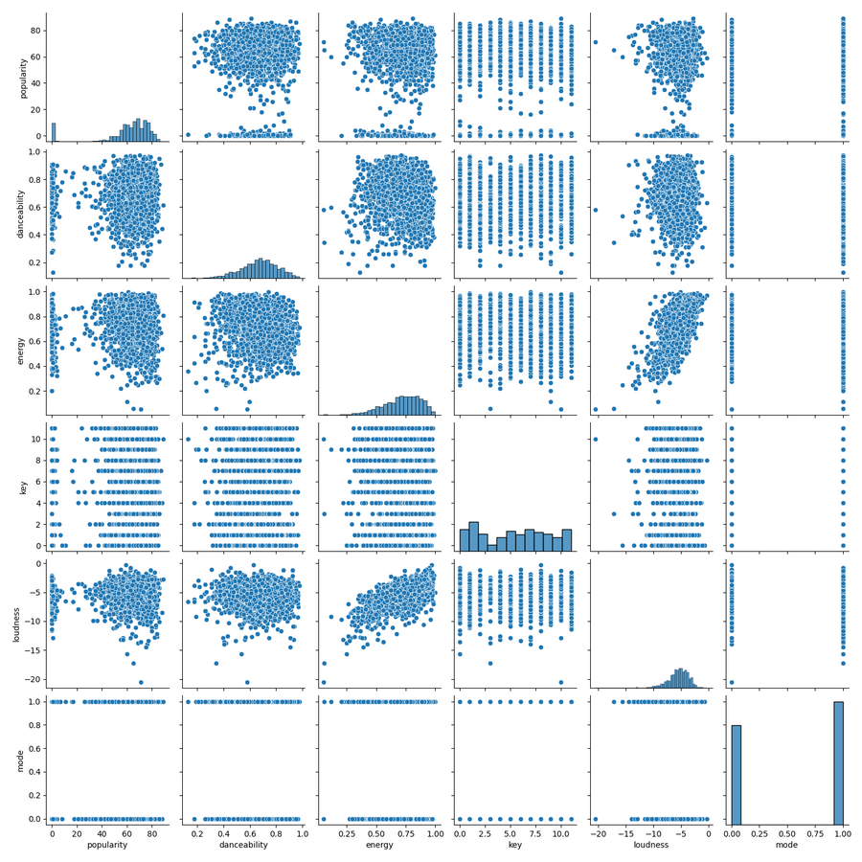
EDA Process and Insights
Initial Exploration:
Loaded dataset; observed first few rows and identified attributes.
Dataset Overview:
Shape: 2000 rows, 18 columns.
Data types: Predominantly numerical.
Missing Values:
Checked for nulls; found no missing values.
Variable Relationships:
Created a pairplot for variable analysis.

Slide 5


EDA Process and Insights Continued
Focused on:
Loudness vs. Popularity
Valence vs. Popularity
Distribution Analysis:
Bar plot: Song distribution by year.
Box plot: Popularity distribution over time.

Slide 6



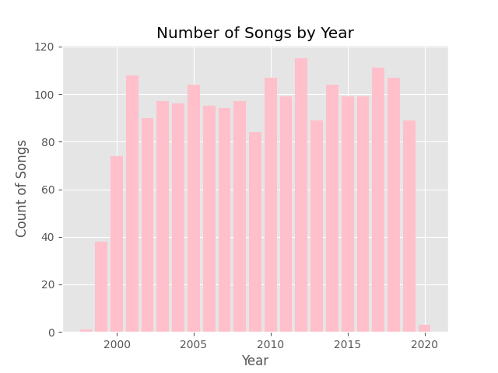
EDA Process and Insights Continued
Barplot
Displays songs by year
The distribution is somewhat evenly spread out and shows the year ranges from 1998-2020
2012 was the year that had the highest count for the songs

Slide 7

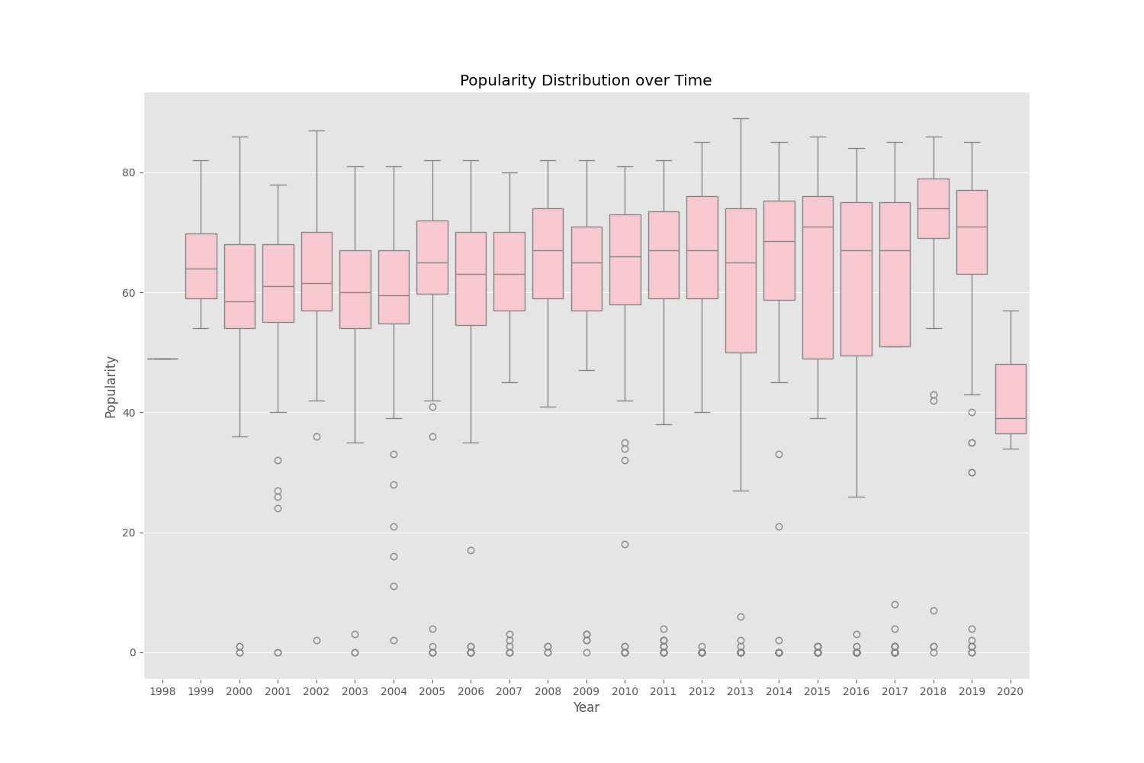
EDA Process and Insights Continued
Boxplot
Displays the popularity distribution over time
The year that had the highest popularity was 2013 based on the boxplot distribution
All the popularity distributions have outliers from each year with low popularity

Slide 8
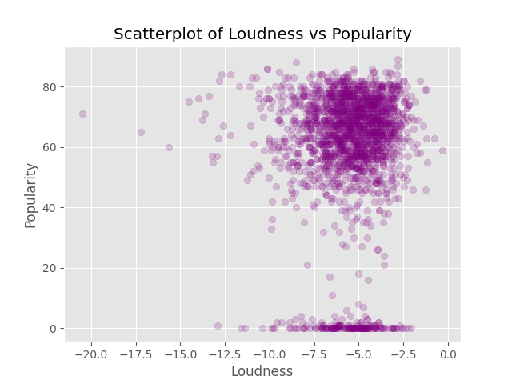
EDA Process and Insights Continued
Scatterplot
Displays the relationship between loudness and popularity
There is a positive relationship between loudness and popularity
There is a cluster of outliers towards the bottom of the graph indicating other factors also affect a song’s popularity

Slide 9
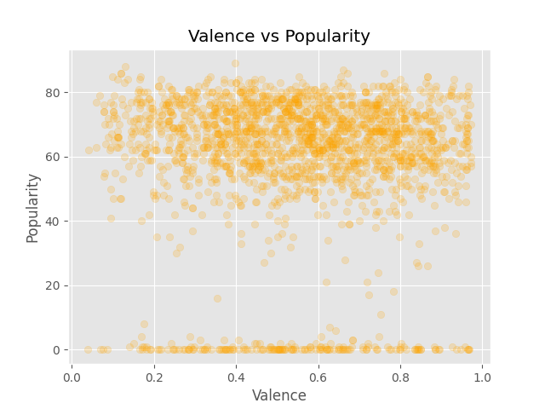
EDA Process and Insights Continued
Scatterplot
Displays the relationship between valence and popularity
The scatterplot indicates there is likely no correlation between valence and popularity
There is a cluster of outliers towards the bottom of the graph indicating other factors also affect a song’s popularity

Slide 10


Summary of Findings
Popularity distribution shows variability over the years, with some outliers in the distribution
The positive relationship between loudness and popularity suggests that louder songs tend to be more popular
The weak relationship between valence and popularity indicates that valence does not affect a song’s popularity

Slide 11

Recommendations and Future Considerations
No Correlation:
Valence and popularity show no correlation, suggesting the need for further analysis of other attributes
Data Enhancement:
Collecting more recent data could provide additional insights
Stream Data:
Findings data for the number of streams for the songs may enhance the analysis of song popularity

Slide 12


Thank you!

